Slide 1
Airbnb Data Analysis By Gouri Phadtare

Slide 2
Agenda
Objective
Background
Key Findings
Appendix:
- Data Methodology
- Data Assumptions

Slide 3
Objective
Improve strategies to review the business in the post covid period.
Understand customer preferences and user experience trends for Airbnb NYC business.
Provide early recommendations for new acquisitions and improving customer experience.

Slide 4
Background
The COVID-19 pandemic affected Airbnb business due to travel restrictions.
The revenue took the largest hit in NYC in the Q2 of 2020.
Now that the travel restrictions are lifted, the business should be operated to recover the loss.

Slide 5
Key findings

Slide 6
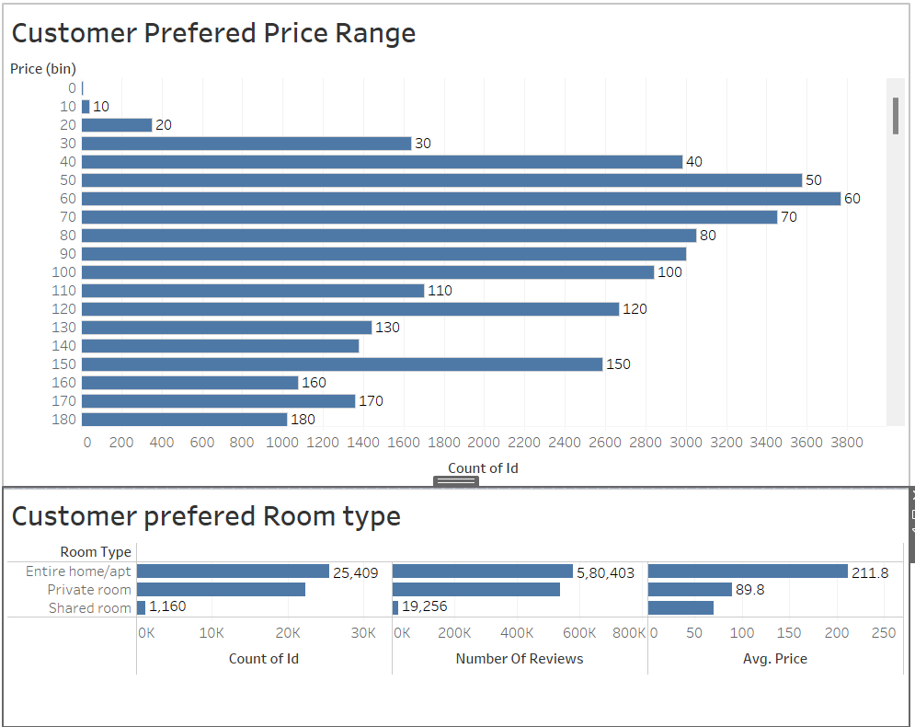
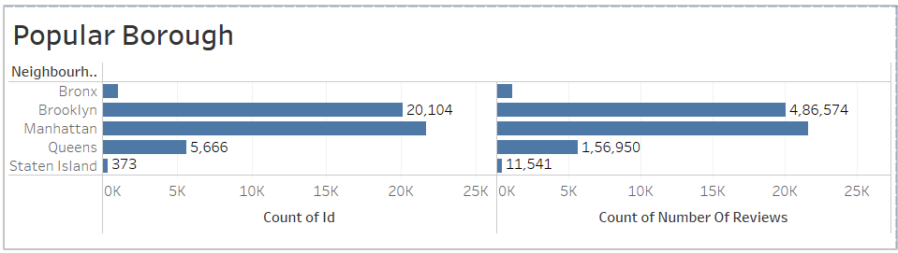
1.Customer Preferences
Low to medium prices ranging from 60$-150$ preferred by customers.
Entire home/Apt. highly preferred by customers on basis of price, number of reviews and listings. Followed by Pvt rooms.
Manhattan being most popular borough followed by Brooklyn for highest bookings and number of reviews.

Slide 7
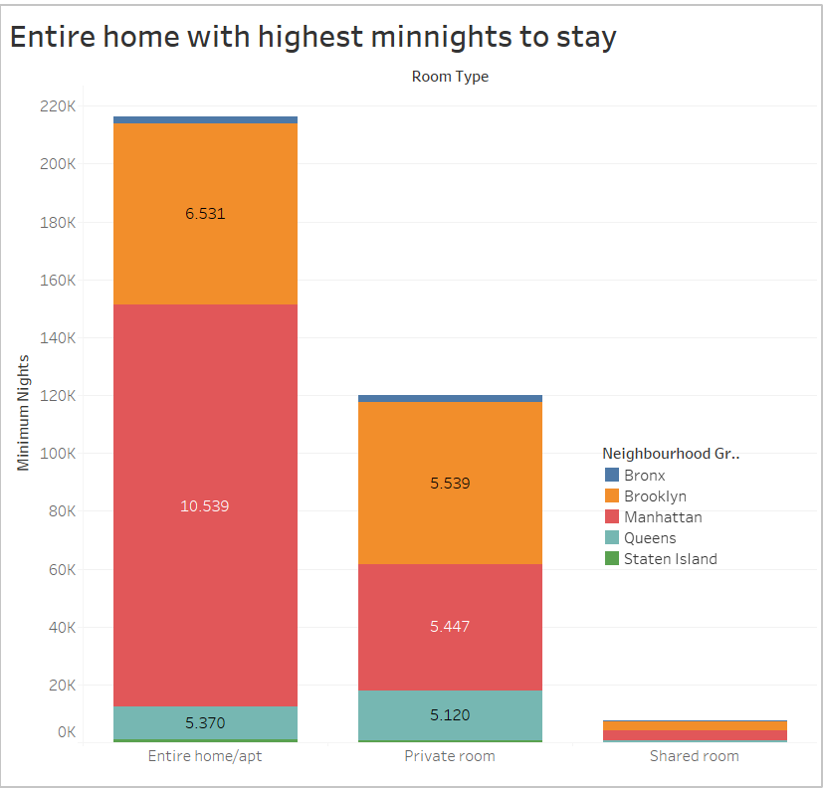
2. Entire homes with highest minimum nights to stay
Entire home/apt types are preferred more by the customers followed by Private rooms as they available for a higher number of minimum night’s stay.
Manhattan consist of maximum Entire homes and private rooms with highest min nights to stay.
Brooklyn has second most Entire homes and private rooms with largest min nights to stay.

Slide 8
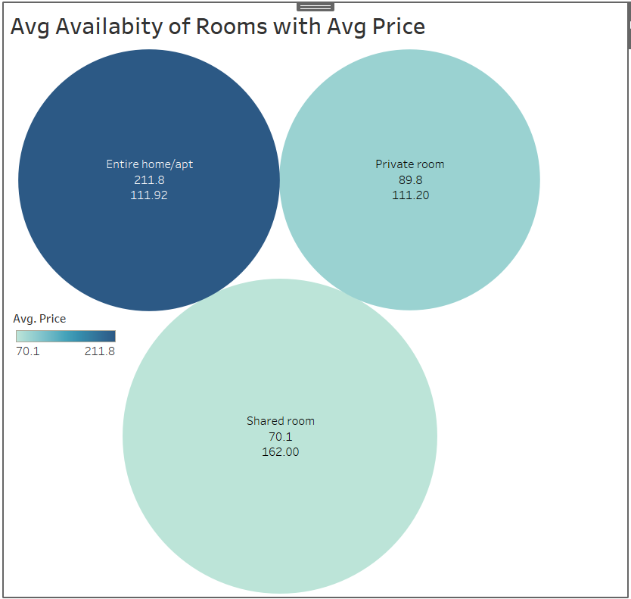
3.Entire Home available for average 100 days
Having a high price range with average price 211$, Entire home/apt types of rooms are available for 112 days.
Private rooms available for average of 111 days with low average price 90$
Shared rooms around 162 days on average being available with the lowest in average price 70$ .

Slide 9
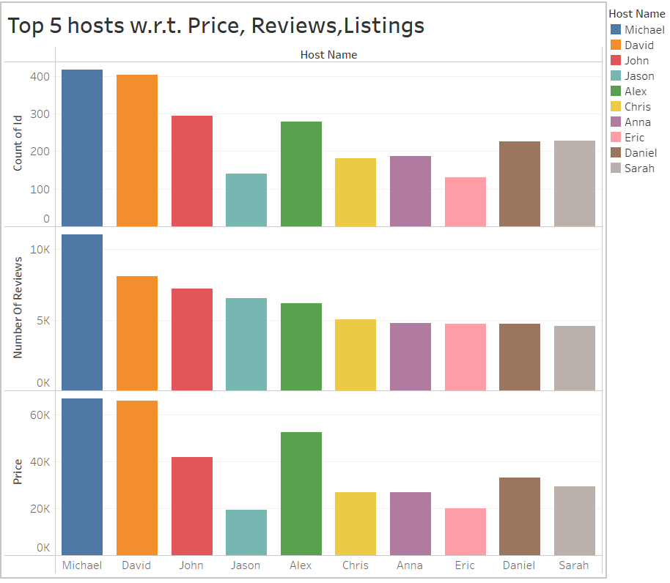
4.Top 5 Hosts based on Price, Reviews, &Listings
Michael is the topmost hosts receives highest reviews for his listed sites with high price range.
David, Alex, John, and Daniel are the next 4 topmost hosts followed by Michael.
We can have one on conversation with hosts to get unpopular properties more traction.

Slide 10
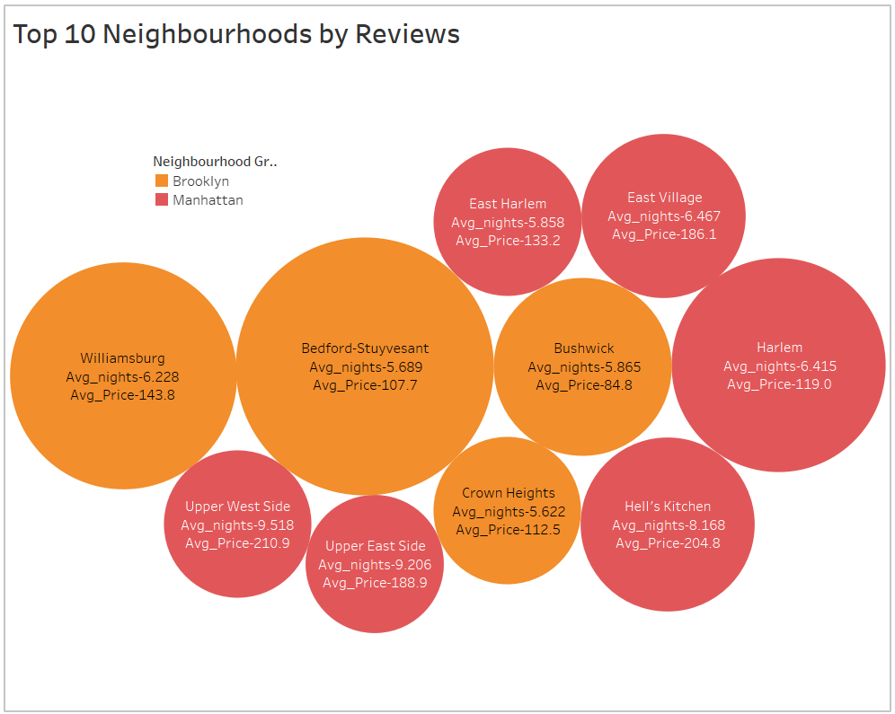
5. Top 10 Neighborhoods by Reviews
Bedford-Stuyvesant, Williamsburg, Bushwick, Harlem and Crown heights are 5 topmost neighborhoods by reviews.
Top 10 neighborhoods belongs to Manhattan and Brooklyn.
Average price offered ranges 110 -210 $ with 5-10 days of average min nights stay

Slide 11
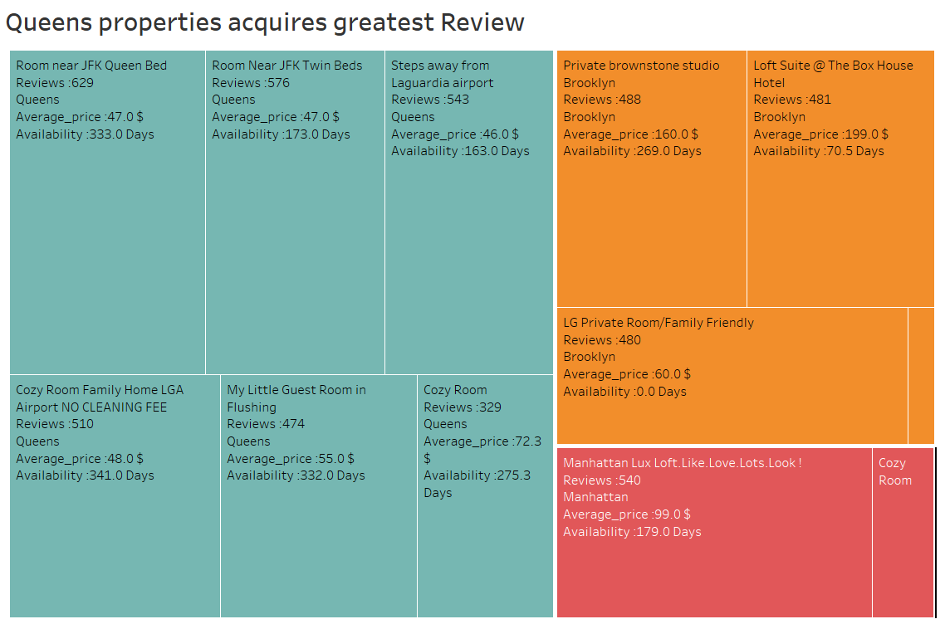
6. Top 10 Properties by Reviews
Rooms near JFK Queen Bed, Cozy Room family home LGA, Steps away from LaGuardia airport, Cozy Rooms, Private brownstone studio are top 5 properties by reviews.
Top 10 properties belongs to Queens and Brooklyn.
Low Average price offered by Queens properties with availability 300+ days.

Slide 12
Appendix-data methodology
We conducted thorough analysis of Airbnb data. The process includes:
Data cleaning for missing values
Using EDA finding customer preferences based on
- Area
- Price
- Types of Properties
- Number of listing
- Minimum number of nights

Slide 13
Appendix-data assumptions
We assume that:
Data prior to COVID -19 period was achieving desired revenue.
Company does not want to expand to new territories.

Slide 14
Thank You

